Slide 1
H.A.P.P.Y. Restaurant Management System
Apoorva Srinivas,Prerana Patil, Kushall Dayal, Dang Bich Thuy Le, Dan To

Slide 2
About H.A.P.P.Y. Restaurant
The H.A.P.P.Y. (Heaven At People’s Preferred Yearning) Restaurant:
Gaining popularity amongst the locals for its delicious food and great staff.
Mostly fully occupied
Receiving raving reviews from customers.
Problem:
Lack of proper record-keeping
Solution:
Developing a database management system to help in management and make the business more profitable.

Slide 3
Project Scope
Database Management System will support:
Order Management System
Inventory Management
Reviews by Customers

Slide 4
Use Cases
Manager​:
Would like to know the monthly revenue throughout a year.
Would like to be able to check billing with order items on a certain date.
Would like to check reviews by customers.
Chef:
Would like to know which food customers like and order most.
Customer:
Would like to see the availability of meals in the restaurant.

Slide 5
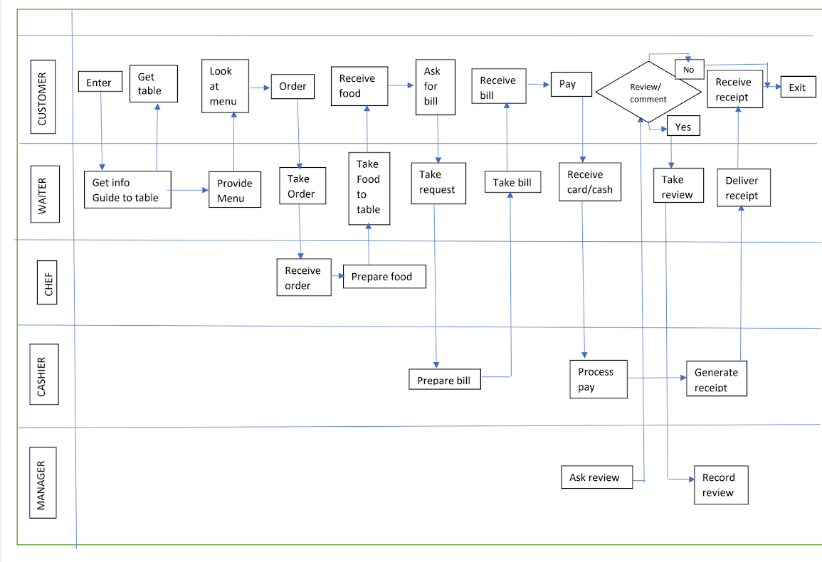
Swim Lane Diagram - Main Process

Slide 6
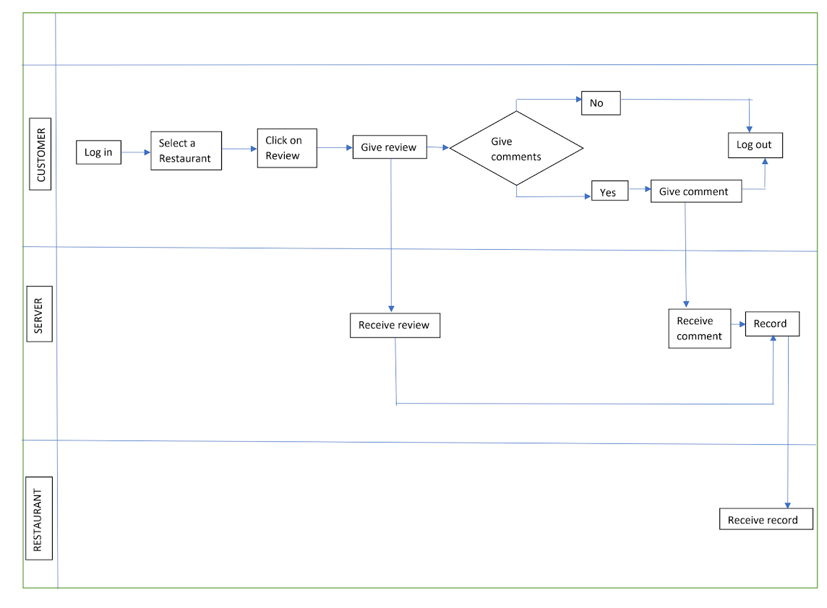
Swim Lane Diagram - Online Review System

Slide 7
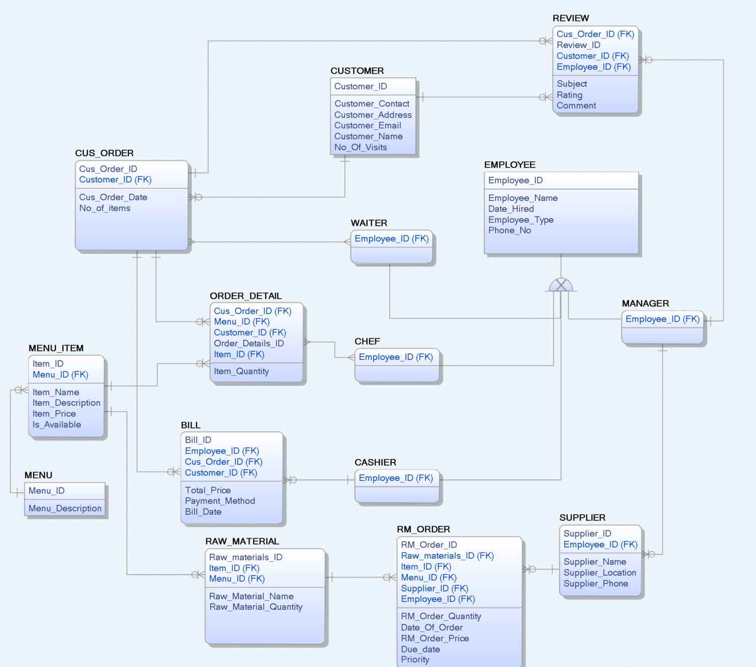
Data Model

Slide 8
Business Metrics
Revenue & Billing:
Review daily and monthly change in revenue throughout the year.
Favorite Food:
Review food items customers like and order most.

Slide 9
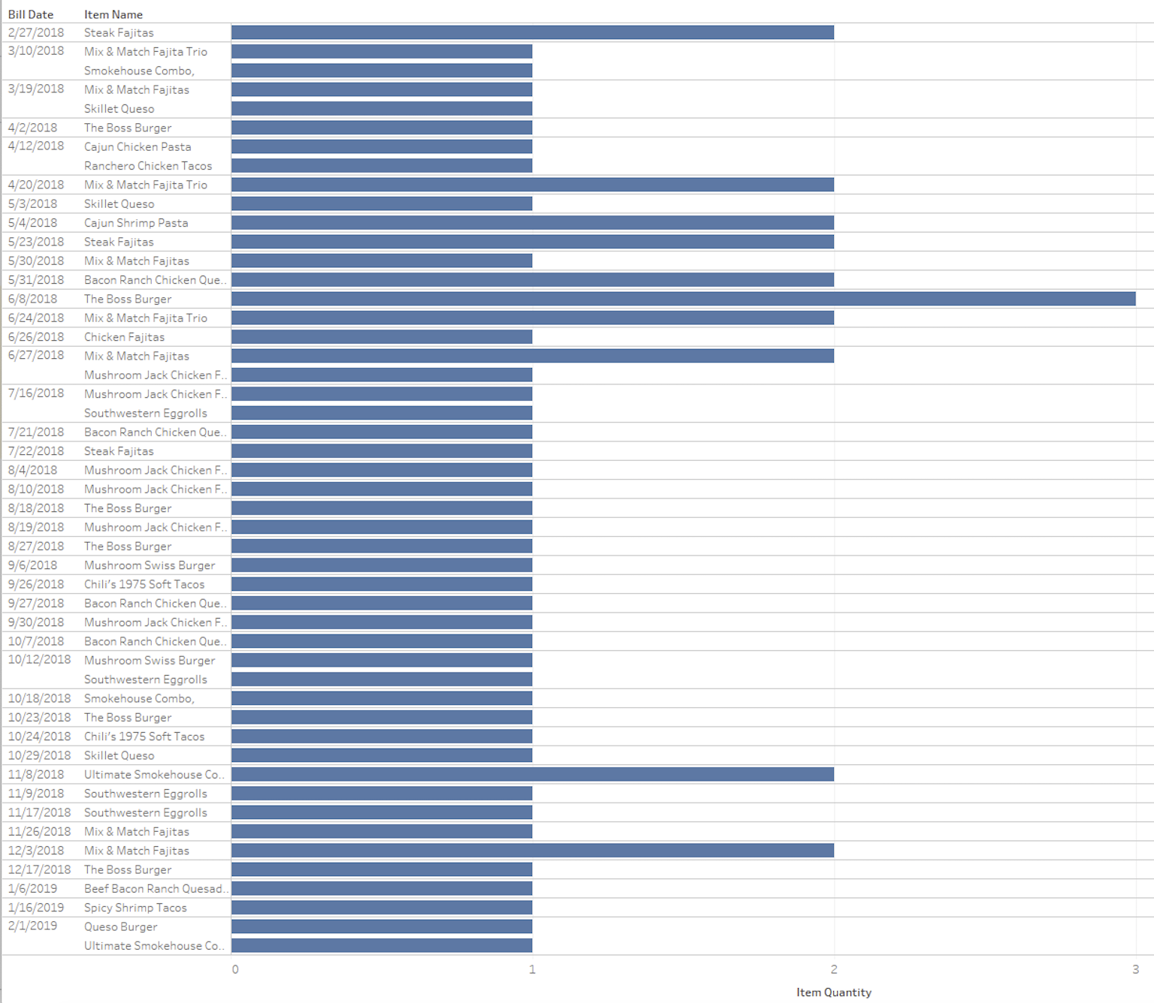
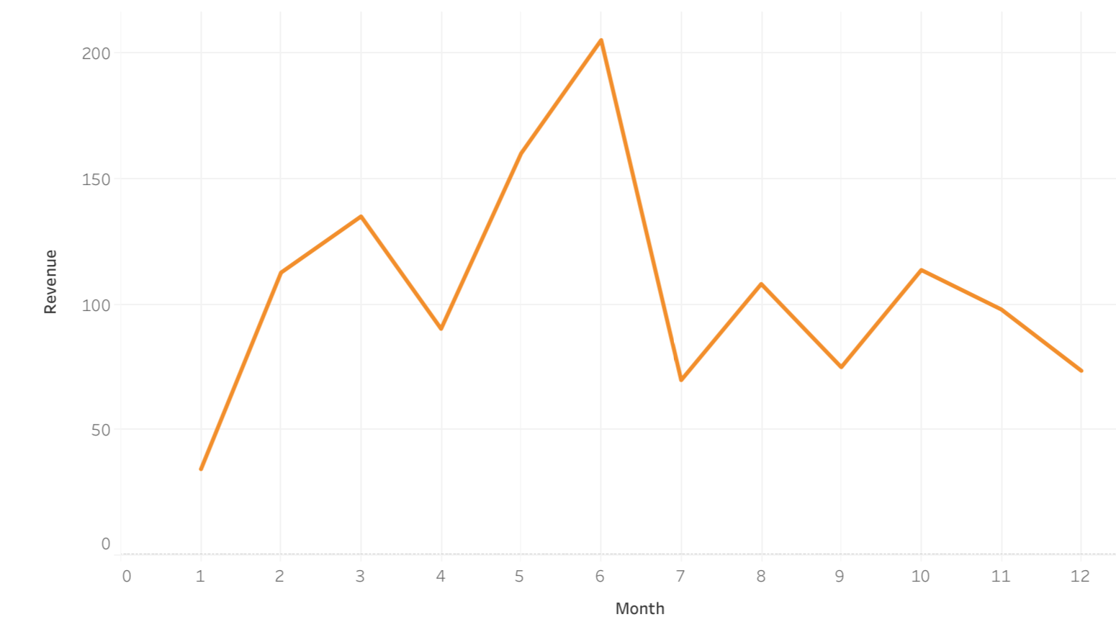
Business Metrics: Revenue & Billing

Slide 10
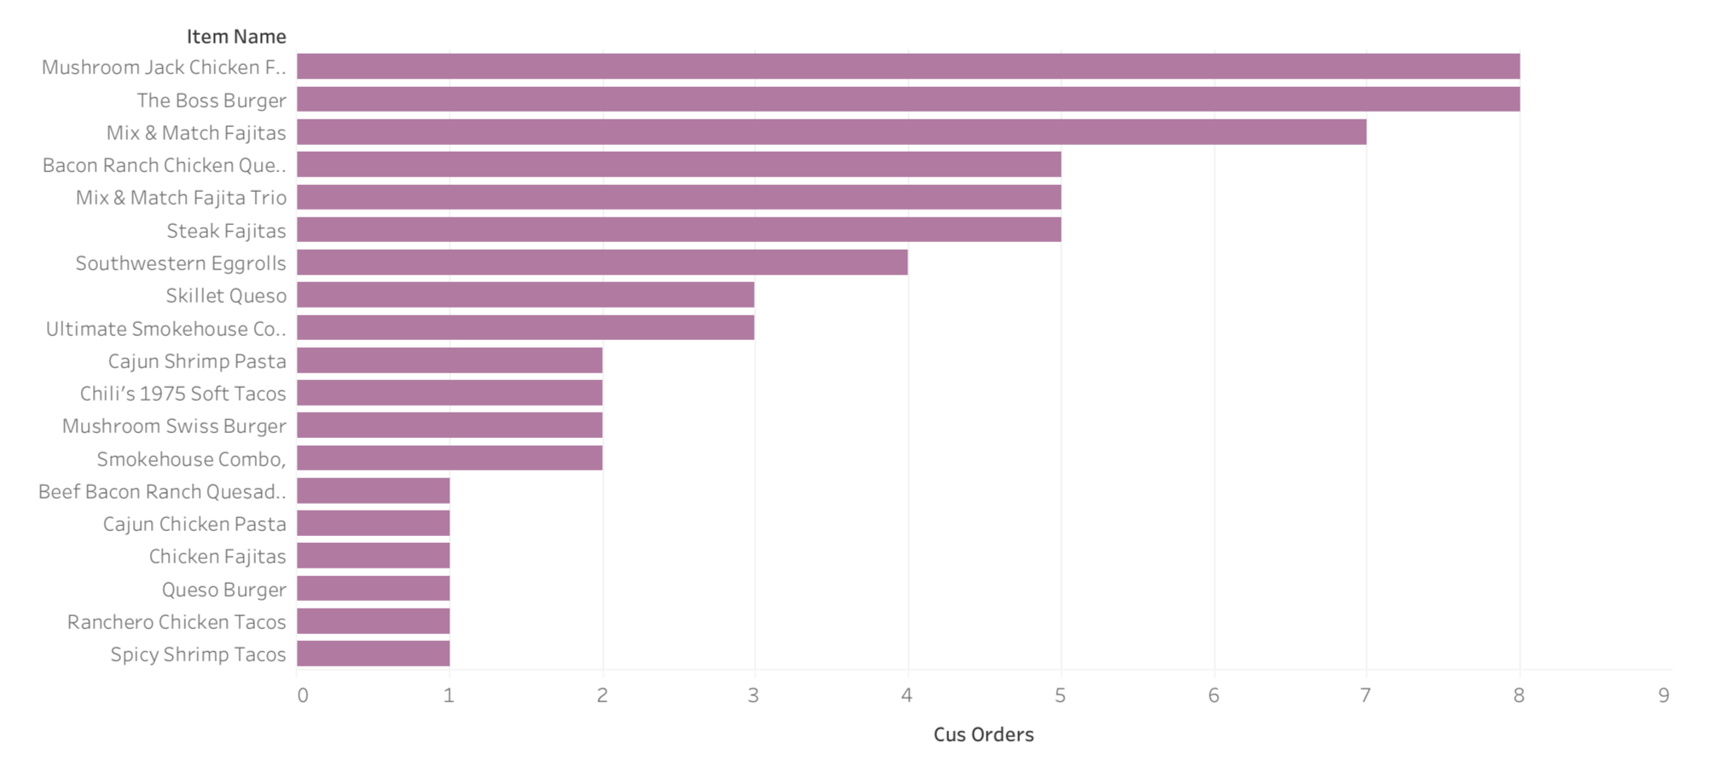
Business Metrics: Favorite food

Slide 11
Summary
What did we learn from this project?
Understood how a detailed and organized database can help smooth running of a business.
Understood DDL, DML in MySQL such as how to create tables, SQL queries, triggers, procedures
and functions.
What problems did we encounter during the project?
Conceptualization of relationships and cardinalities between the entities.
Data-type mismatch.
Foreign Key error while populating tables.
How did we solve these problems?
Discussed many use cases to clarify the relation and the cardinalities among the entities.
Ensured the data types were matched properly across tables for querying and joining.
Data types for foreign key columns across tables need to be the same. Tables need to be populated
/dropped sequentially.

Slide 12
Future Methodologies
Spend more time in planning phase to reduce repetitions in the execution phase.
Scalability:
Accommodate restaurants at multiple locations.
Include other business processes such as payroll management, staff attendance etc.
Include online ordering and home delivery features.

Slide 13
Thank you

